Slide 1

Stage 5 Long And Winding Road Course Designer: Ken Wang
Long And Winding Road (inspired by Area 4 Long And Winding Road stage) is a 26 round, 130 point, COMSTOCK Long course. There are 13 USPSA targets. The best 2 hits per target will score.
The handgun start position is standing with feet touching the start stick with wrists below belt. Handgun is loaded and holstered. PCC start position is standing with feet touching the start stick with PCC loaded, stock on belt, safety on.
On the audible start signal, engage all targets from within the shooting area.

Slide 2
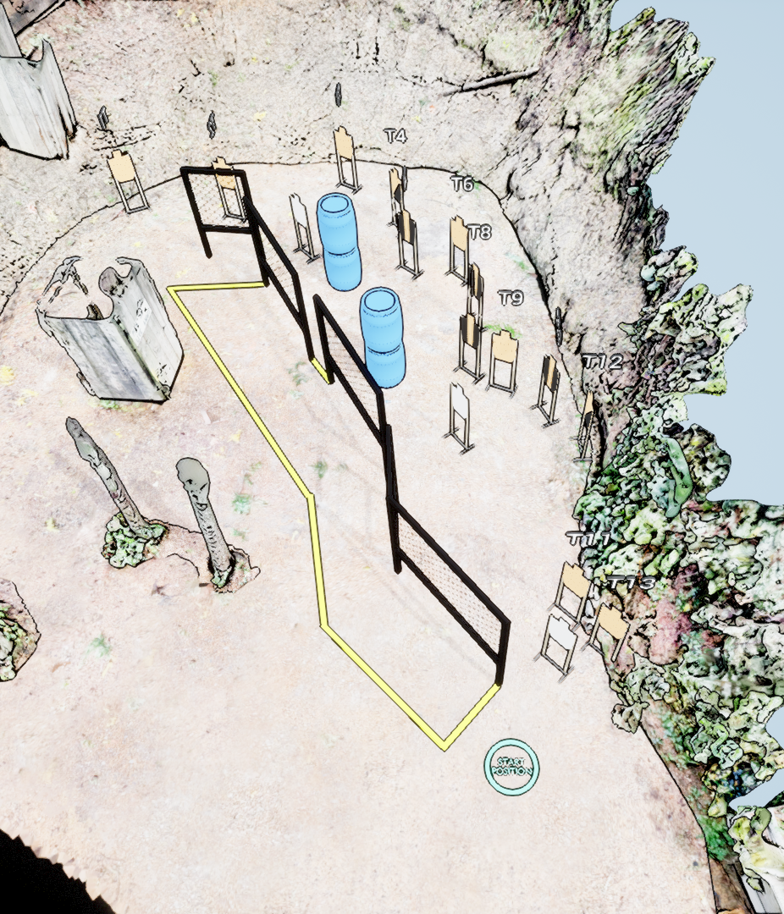
 | Stage 5 Long And Winding Road Course Designer: Ken Wang

